Slide 1
Girl Scouts LEGO Robotics
Rockin’
Robots
Meeting 6 – Circle & Wheels
August 8, 2017

Slide 2
What are we doing today?
Review your core value sentences
Learn about wheel circumference
Program for wheel rotations
Run the robot
Make the car go the right amount of distance

Slide 3
Core Values Homework

Slide 4
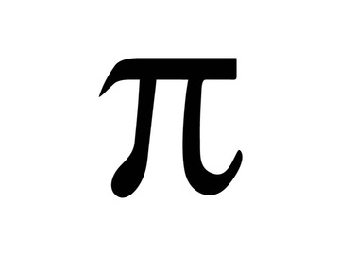
The Magic of Pi
π = pi =

Slide 5
Circumference of a Circle
Circumference =
π × diameter
π × 2 × radius
Diameter
Circumference
Radius

Slide 6
Hands-on 1 – Pi Program
Python
>>> def bigWheelDistance(num):
... pi = 3.14159
... print(pi*diameter*num)
Notes:
Efrom
Nathan

Slide 7
Next Meeting
Turning the robot

